Slide 1
A Geometric Progression Problem
Source: Aidan Burrows
(don’t know where he got it from)

Slide 2
Note to Teacher
Hand out the worksheets and if they struggle take them through the specific problem that follows.
You can also set the related problem as an extension task (slide 9).

Slide 3
A Geometric Progression Problem
The second term of a geometric progression is greater than the first term by 20.
The fourth term is greater than the first by 35.
Find the two possible values of the first term and associated common ratio.
Notes:
This is a problem Aidan Burrows gave his 6th form class.

Slide 4
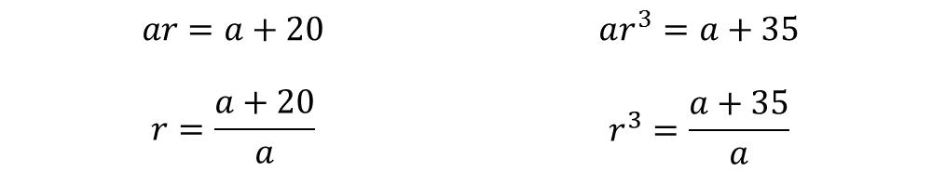
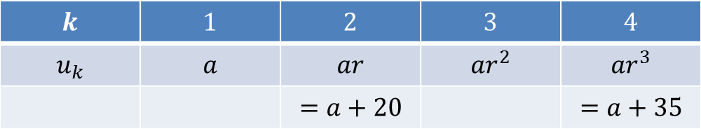
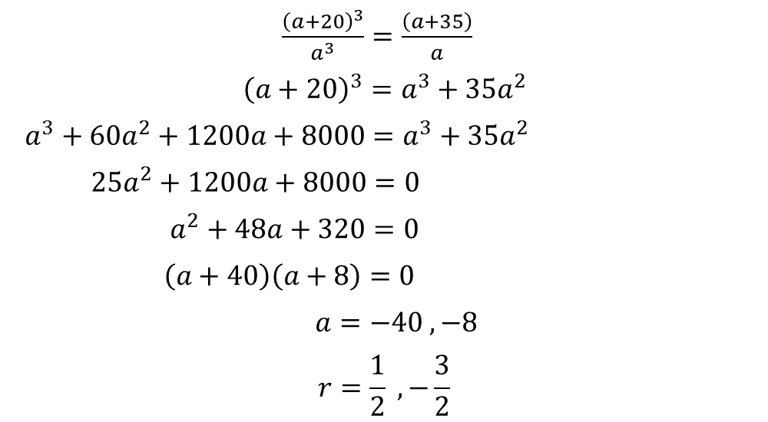
$$k$$ | $$1$$ | $$2$$ | $$3$$ | $$4$$
$$u_{k}$$ | $$a$$ | $$ar$$ | $$ar^{2}$$ | $$ar^{3}$$
 |  | $$=a+20$$ |  | $$=a+35$$
$$ar=a+20$$ | $$ar^{3}=a+35$$
$$r=\frac{a+20}{a}$$ | $$r^{3}=\frac{a+35}{a}$$
$\frac{{\left(a+20\right)}^{3}}{a^{3}}=\frac{\left(a+35\right)}{a}$
${\left(a+20\right)}^{3}=a^{3}+{35a}^{2}$
$a^{3}+60a^{2}+1200a+8000=a^{3}+35a^{2}$
$25a^{2}+1200a+8000=0$
$a^{2}+48a+320=0$
$\left(a+40\right)\left(a+8\right)=0$
$a=−40 , −8$
$$r=\frac{1}{2} , −\frac{3}{2}$$

Slide 5
$$k$$ | $$1$$ | $$2$$ | $$3$$ | $$4$$
$$u_{k}$$ | $$a$$ | $$ar$$ | $$ar^{2}$$ | $$ar^{3}$$
 |  | $$=a+20$$ |  | $$=a+35$$
$$ar=a+20$$ | $$ar^{3}=a+35$$
$$r=\frac{a+20}{a}$$ | $$r^{3}=\frac{a+35}{a}$$
$\frac{{\left(a+20\right)}^{3}}{a^{3}}=\frac{\left(a+35\right)}{a}$
${\left(a+20\right)}^{3}=a^{3}+{35a}^{2}$
$a^{3}+60a^{2}+1200a+8000=a^{3}+35a^{2}$
$25a^{2}+1200a+8000=0$
$a^{2}+48a+320=0$
$\left(a+40\right)\left(a+8\right)=0$
$a=−40 , −8$
$$r=\frac{1}{2} , −\frac{3}{2}$$

Slide 7
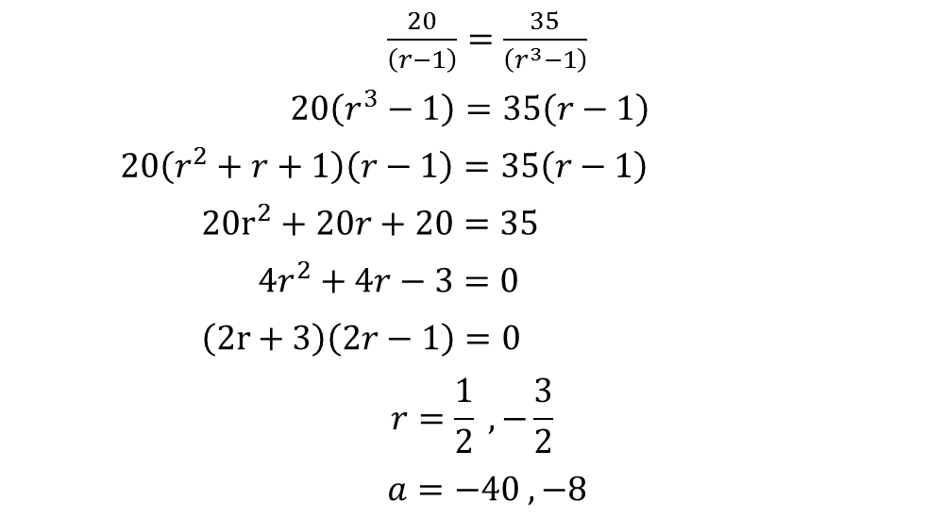

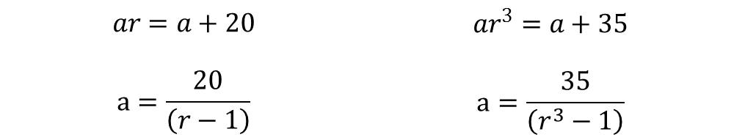
$$k$$ | $$1$$ | $$2$$ | $$3$$ | $$4$$
$$u_{k}$$ | $$a$$ | $$ar$$ | $$ar^{2}$$ | $$ar^{3}$$
 |  | $$=a+20$$ |  | $$=a+35$$
$$ar=a+20$$ | $$ar^{3}=a+35$$
$$a=\frac{20}{\left(r−1\right)}$$ | $$a=\frac{35}{\left(r^{3}−1\right)}$$
Alternatively:
$$(r≠1)$$
$\frac{20}{\left(r−1\right)}=\frac{35}{\left(r^{3}−1\right)}$
$20\left(r^{3}−1\right)=35\left(r−1\right)$
$20\left(r^{2}+r+1\right)\left(r−1\right)=35\left(r−1\right)$
$20r^{2}+20r+20=35$
$4r^{2}+4r−3=0$
$\left(2r+3\right)\left(2r−1\right)=0$
$$r=\frac{1}{2} , −\frac{3}{2}$$
$a=−40 , −8$

Slide 8
$$k$$ | $$1$$ | $$2$$ | $$3$$ | $$4$$
$$u_{k}$$ | $$a$$ | $$ar$$ | $$ar^{2}$$ | $$ar^{3}$$
 |  | $$=a+20$$ |  | $$=a+35$$
$$ar=a+20$$ | $$ar^{3}=a+35$$
$$a=\frac{20}{\left(r−1\right)}$$ | $$a=\frac{35}{\left(r^{3}−1\right)}$$
Alternatively:
$$(r≠1)$$
$\frac{20}{\left(r−1\right)}=\frac{35}{\left(r^{3}−1\right)}$
$20\left(r^{3}−1\right)=35\left(r−1\right)$
$20\left(r^{2}+r+1\right)\left(r−1\right)=35\left(r−1\right)$
$20r^{2}+20r+20=35$
$4r^{2}+4r−3=0$
$\left(2r+3\right)\left(2r−1\right)=0$
$$r=\frac{1}{2} , −\frac{3}{2}$$
$a=−40 , −8$

Slide 10

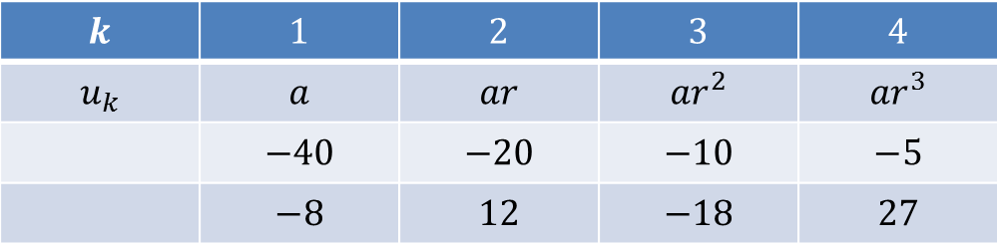
$$a=−40 , −8$$
$$r=\frac{1}{2} , −\frac{3}{2}$$
Answer:
, respectively
Check:
$$k$$ | $$1$$ | $$2$$ | $$3$$ | $$4$$
$$u_{k}$$ | $$a$$ | $$ar$$ | $$ar^{2}$$ | $$ar^{3}$$
 | $$−40$$ | $$−20$$ | $$−10$$ | $$−5$$
 | $$−8$$ | $$12$$ | $$−18$$ | $$27$$

Slide 11
A Related Geometric Progression Problem
The second term of a geometric progression is greater than the first term by 20.
By what amount should the fourth term be greater than the first to yield a unique solution?
Find the first term and common ratio.

Slide 12
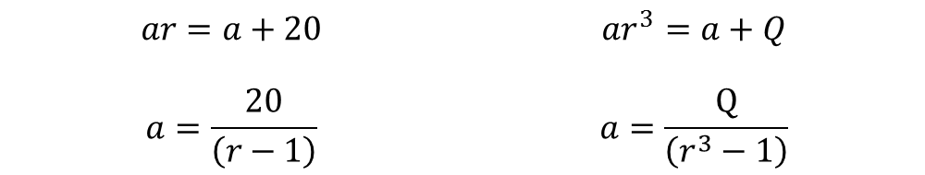
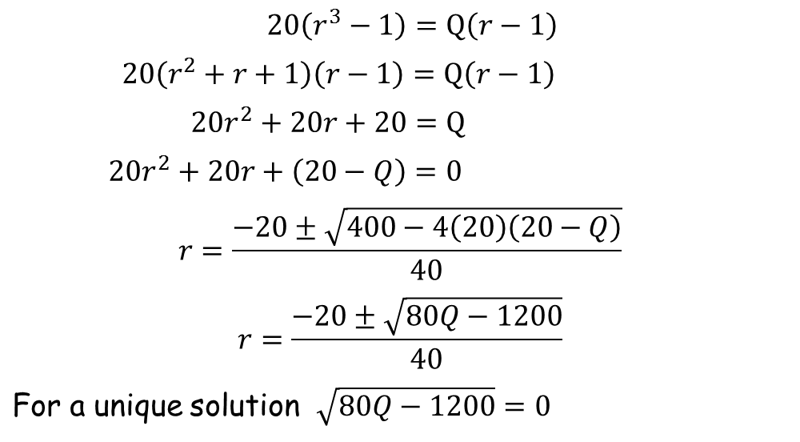
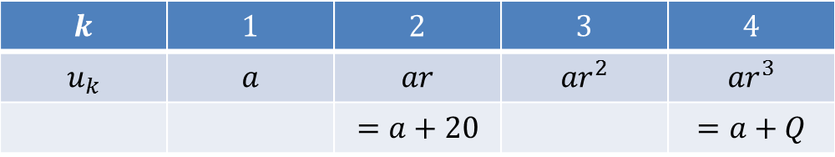
$$k$$ | $$1$$ | $$2$$ | $$3$$ | $$4$$
$$u_{k}$$ | $$a$$ | $$ar$$ | $$ar^{2}$$ | $$ar^{3}$$
 |  | $$=a+20$$ |  | $$=a+Q$$
$$ar=a+20$$ | $$ar^{3}=a+Q$$
$$a=\frac{20}{\left(r−1\right)}$$ | $$a=\frac{Q}{\left(r^{3}−1\right)}$$
$20\left(r^{3}−1\right)=Q\left(r−1\right)$
$20\left(r^{2}+r+1\right)\left(r−1\right)=Q\left(r−1\right)$
$20r^{2}+20r+20=Q$
$20r^{2}+20r+\left(20−Q\right)=0$
$$r=\frac{−20±\sqrt{400−4\left(20\right)\left(20−Q\right)}}{40}$$
$$r=\frac{−20±\sqrt{80Q−1200}}{40}$$
For a unique solution $\sqrt{80Q−1200}=0$

Slide 13
$$k$$ | $$1$$ | $$2$$ | $$3$$ | $$4$$
$$u_{k}$$ | $$a$$ | $$ar$$ | $$ar^{2}$$ | $$ar^{3}$$
 |  | $$=a+20$$ |  | $$=a+Q$$
$$ar=a+20$$ | $$ar^{3}=a+Q$$
$$a=\frac{20}{\left(r−1\right)}$$ | $$a=\frac{Q}{\left(r^{3}−1\right)}$$
$20\left(r^{3}−1\right)=Q\left(r−1\right)$
$20\left(r^{2}+r+1\right)\left(r−1\right)=Q\left(r−1\right)$
$20r^{2}+20r+20=Q$
$20r^{2}+20r+\left(20−Q\right)=0$
$$r=\frac{−20±\sqrt{400−4\left(20\right)\left(20−Q\right)}}{40}$$
$$r=\frac{−20±\sqrt{80Q−1200}}{40}$$
For a unique solution $\sqrt{80Q−1200}=0$

Slide 14
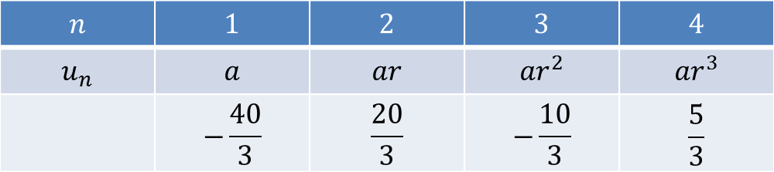
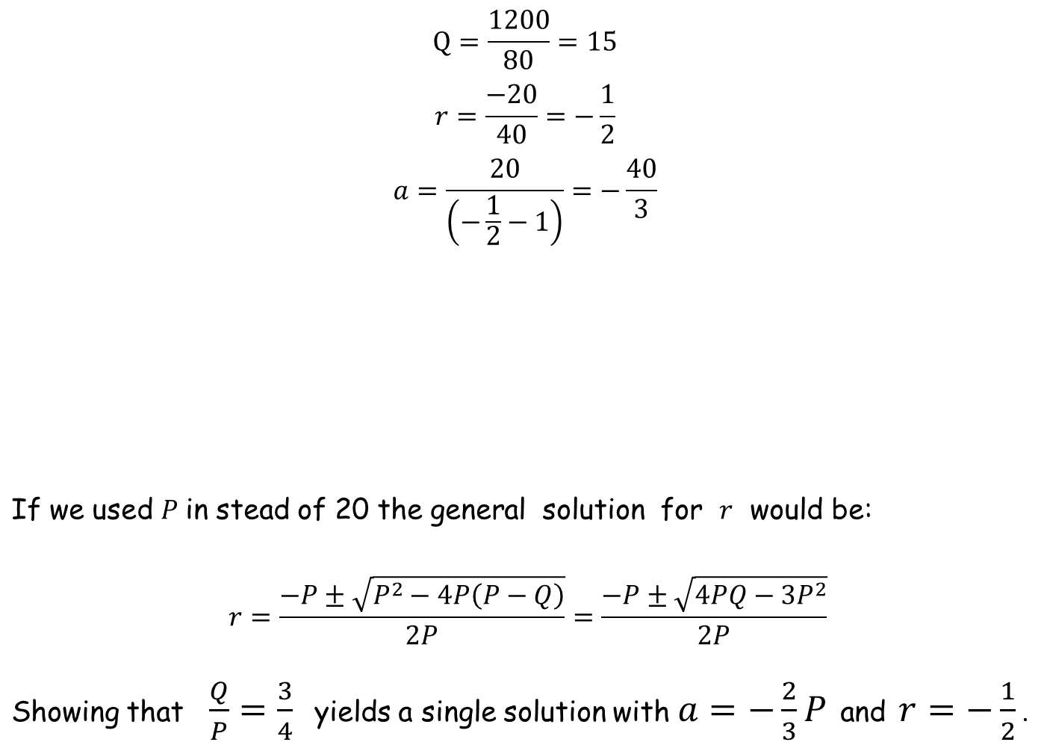
$$Q=\frac{1200}{80}=15$$
$$r=\frac{−20}{40}=−\frac{1}{2}$$
$$a=\frac{20}{\left(−\frac{1}{2}−1\right)}=−\frac{40}{3}$$
If we used $P$ in stead of 20 the general solution for $r$ would be:
$$r=\frac{−P±\sqrt{P^{2}−4P\left(P−Q\right)}}{2P}=\frac{−P±\sqrt{4PQ−3P^{2}}}{2P}$$
Showing that $\frac{Q}{P}=\frac{3}{4}$ yields a single solution with $a=−\frac{2}{3}P$ and $r=−\frac{1}{2}$ .
$$n$$ | $$1$$ | $$2$$ | $$3$$ | $$4$$
$$u_{n}$$ | $$a$$ | $$ar$$ | $$ar^{2}$$ | $$ar^{3}$$
 | $$−\frac{40}{3}$$ | $$\frac{20}{3}$$ | $$−\frac{10}{3}$$ | $$\frac{5}{3}$$

Slide 15
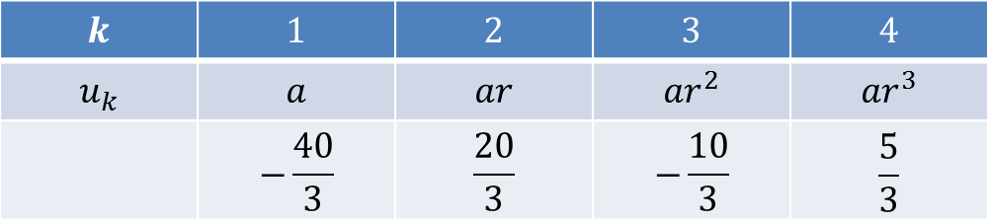
$$Q=\frac{1200}{80}=15$$
$$r=\frac{−20}{40}=−\frac{1}{2}$$
$$a=\frac{20}{\left(−\frac{1}{2}−1\right)}=−\frac{40}{3}$$
If we used $P$ in stead of 20 the general solution for $r$ would be:
$$r=\frac{−P±\sqrt{P^{2}−4P\left(P−Q\right)}}{2P}=\frac{−P±\sqrt{4PQ−3P^{2}}}{2P}$$
Showing that $\frac{Q}{P}=\frac{3}{4}$ yields a single solution with $a=−\frac{2}{3}P$ and $r=−\frac{1}{2}$ .
$$k$$ | $$1$$ | $$2$$ | $$3$$ | $$4$$
$$u_{k}$$ | $$a$$ | $$ar$$ | $$ar^{2}$$ | $$ar^{3}$$
 | $$−\frac{40}{3}$$ | $$\frac{20}{3}$$ | $$−\frac{10}{3}$$ | $$\frac{5}{3}$$

Slide 16

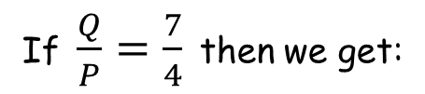

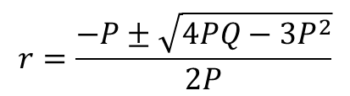
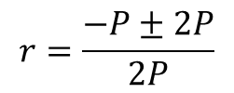
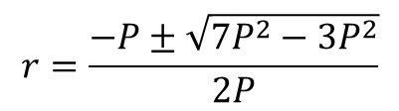
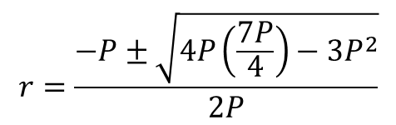
$$r=\frac{−P±\sqrt{4PQ−3P^{2}}}{2P}$$
$$r=\frac{−P±\sqrt{4P\left(\frac{7P}{4}\right)−3P^{2}}}{2P}$$
If $\frac{Q}{P}=\frac{7}{4}$ then we get:
$$r=\frac{−P±\sqrt{7P^{2}−3P^{2}}}{2P}$$
$$r=\frac{−P±2P}{2P}$$
$r=\frac{1}{2}$ or $r=−\frac{3}{2}$
and $a=−2P$ or $a=−\frac{2P}{5}$, respectively.
Do your answers to the original problem accord with the above?
They should!

Slide 18
Resources

Slide 19
A Geometric Progression Problem
The second term of a geometric progression is greater than the first term by 4.
The fourth term is greater than the first by 7.
Find the two possible values of the first term and associated common ratio.
SIC_13
A Geometric Progression Problem
The second term of a geometric progression is greater than the first term by 8.
The fourth term is greater than the first by 14.
Find the two possible values of the first term and associated common ratio.
SIC_13
Notes:
Common ratio, r=-1.5 and 0.5 for all of the above. The larger first term is 5 times the smaller one.

Slide 20
A Geometric Progression Problem
The second term of a geometric progression is greater than the first term by 12.
The fourth term is greater than the first by 21.
Find the two possible values of the first term and associated common ratio.
SIC_13
A Geometric Progression Problem
The second term of a geometric progression is greater than the first term by 16.
The fourth term is greater than the first by 28.
Find the two possible values of the first term and associated common ratio.
SIC_13
Notes:
Common ratio, r=-1.5 and 0.5 for all of the above. The larger first term is 5 times the smaller one.

Slide 21
A Geometric Progression Problem
The second term of a geometric progression is greater than the first term by 20.
The fourth term is greater than the first by 35.
Find the two possible values of the first term and associated common ratio.
SIC_13
A Geometric Progression Problem
The second term of a geometric progression is greater than the first term by 24.
The fourth term is greater than the first by 42.
Find the two possible values of the first term and associated common ratio.
SIC_13
Notes:
Common ratio, r=-1.5 and 0.5 for all of the above. The larger first term is 5 times the smaller one.

Slide 22
A Geometric Progression Problem
The second term of a geometric progression is greater than the first term by 28.
The fourth term is greater than the first by 49.
Find the two possible values of the first term and associated common ratio.
SIC_13
A Geometric Progression Problem
The second term of a geometric progression is greater than the first term by 32.
The fourth term is greater than the first by 56.
Find the two possible values of the first term and associated common ratio.
SIC_13
Notes:
Common ratio, r=-1.5 and 0.5 for all of the above. The larger first term is 5 times the smaller one.

Slide 23
A Geometric Progression Problem
The second term of a geometric progression is greater than the first term by 36.
The fourth term is greater than the first by 63.
Find the two possible values of the first term and associated common ratio.
SIC_13
A Geometric Progression Problem
The second term of a geometric progression is greater than the first term by 40.
The fourth term is greater than the first by 70.
Find the two possible values of the first term and associated common ratio.
SIC_13
Notes:
Common ratio, r=-1.5 and 0.5 for all of the above. The larger first term is 5 times the smaller one.

Slide 24
A Geometric Progression Problem
The second term of a geometric progression is greater than the first term by 44.
The fourth term is greater than the first by 77.
Find the two possible values of the first term and associated common ratio.
SIC_13
A Geometric Progression Problem
The second term of a geometric progression is greater than the first term by 48.
The fourth term is greater than the first by 84.
Find the two possible values of the first term and associated common ratio.
SIC_13
Notes:
Common ratio, r=-1.5 and 0.5 for all of the above. The larger first term is 5 times the smaller one.

Slide 25
A Geometric Progression Problem
The second term of a geometric progression is greater than the first term by 52.
The fourth term is greater than the first by 91.
Find the two possible values of the first term and associated common ratio.
SIC_13
A Geometric Progression Problem
The second term of a geometric progression is greater than the first term by 56.
The fourth term is greater than the first by 98.
Find the two possible values of the first term and associated common ratio.
SIC_13
Notes:
Common ratio, r=-1.5 and 0.5 for all of the above. The larger first term is 5 times the smaller one.

Slide 26
A Geometric Progression Problem
The second term of a geometric progression is greater than the first term by 60.
The fourth term is greater than the first by 105.
Find the two possible values of the first term and associated common ratio.
SIC_13
A Geometric Progression Problem
The second term of a geometric progression is greater than the first term by 64.
The fourth term is greater than the first by 112.
Find the two possible values of the first term and associated common ratio.
SIC_13
Notes:
Common ratio, r=-1.5 and 0.5 for all of the above. The larger first term is 5 times the smaller one.

Slide 27
A Geometric Progression Problem
The second term of a geometric progression is greater than the first term by 68.
The fourth term is greater than the first by 119.
Find the two possible values of the first term and associated common ratio.
SIC_13
A Geometric Progression Problem
The second term of a geometric progression is greater than the first term by 72.
The fourth term is greater than the first by 126.
Find the two possible values of the first term and associated common ratio.
SIC_13
Notes:
Common ratio, r=-1.5 and 0.5 for all of the above. The larger first term is 5 times the smaller one.

Slide 28
A Geometric Progression Problem
The second term of a geometric progression is greater than the first term by 76.
The fourth term is greater than the first by 133.
Find the two possible values of the first term and associated common ratio.
SIC_13
A Geometric Progression Problem
The second term of a geometric progression is greater than the first term by 80.
The fourth term is greater than the first by 140.
Find the two possible values of the first term and associated common ratio.
SIC_13
Notes:
Common ratio, r=-1.5 and 0.5 for all of the above. The larger first term is 5 times the smaller one.

